Slide 1
Recommended Use of this Training

Slide 2
Business2Business

Slide 3
Project Creation & Funding

Slide 4
Welcome to Business2Business

Slide 5
Identifying Beneficial Business Relationships

Slide 6
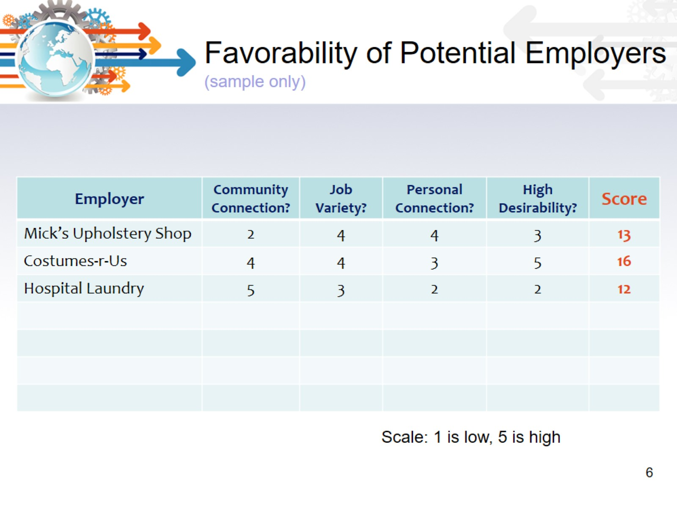
Favorability of Potential Employers (sample only)

Slide 7
Building Business Relationships

Slide 8
Common Goals and Values?

Slide 9
Don’t just tell, SHOW!

Slide 10
Get personal. Listen!

Slide 11
Connect with others

Slide 12
Managing business relationships

Slide 13
Making the business case

Slide 14
Marketing the individual!

Slide 15
Managing disclosure

Slide 16
Supervision for the Employment Support Specialists

Slide 17
Resources

